Slide 1
CSS for Beginners Part 2

Slide 2

Hello Ladies that Code!
I am Renette Ros
I am a software engineer at Entelect.
You can contact me at:
renette.ros@entelect.co.za

Slide 3
Recap – CSS Part 1
What is CSS?
Inline Styling
Colours
Borders, Margin, Padding
Fonts & Text Alignment
Notes:
Last time we talked about CSS Basic. Patricia explained what CSS is and showed you how to use inline styling and you can use it to add colours, borders and fonts to your CV.

Slide 4
Today – CSS Part 2
External and internal style sheets
CSS Selectors
Positioning Elements
Fun Extra: Custom fonts with google fonts
Notes:
Last time we talked about CSS Basics
Just to show everyone where we are going, lets see how our CV started out and what it will look like at the end of this session.

Slide 5

Where we started
Notes:
Just to give everyone an

Slide 6
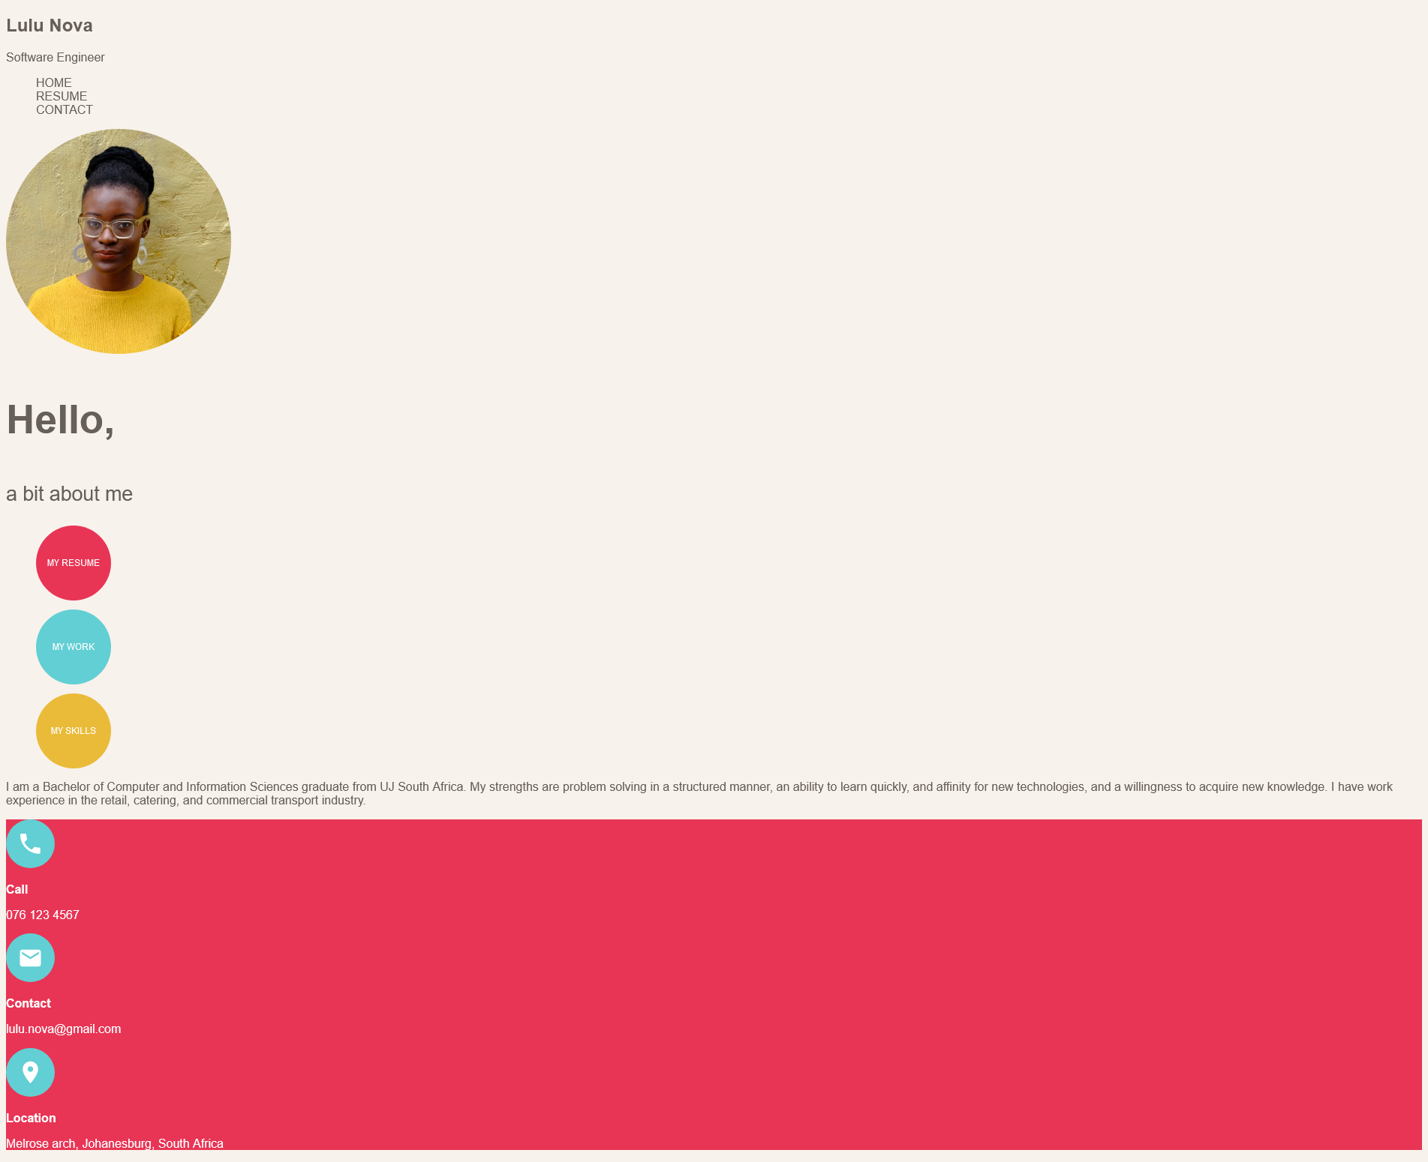
After CSS Part 1
Notes:
Just to give everyone an

Slide 7
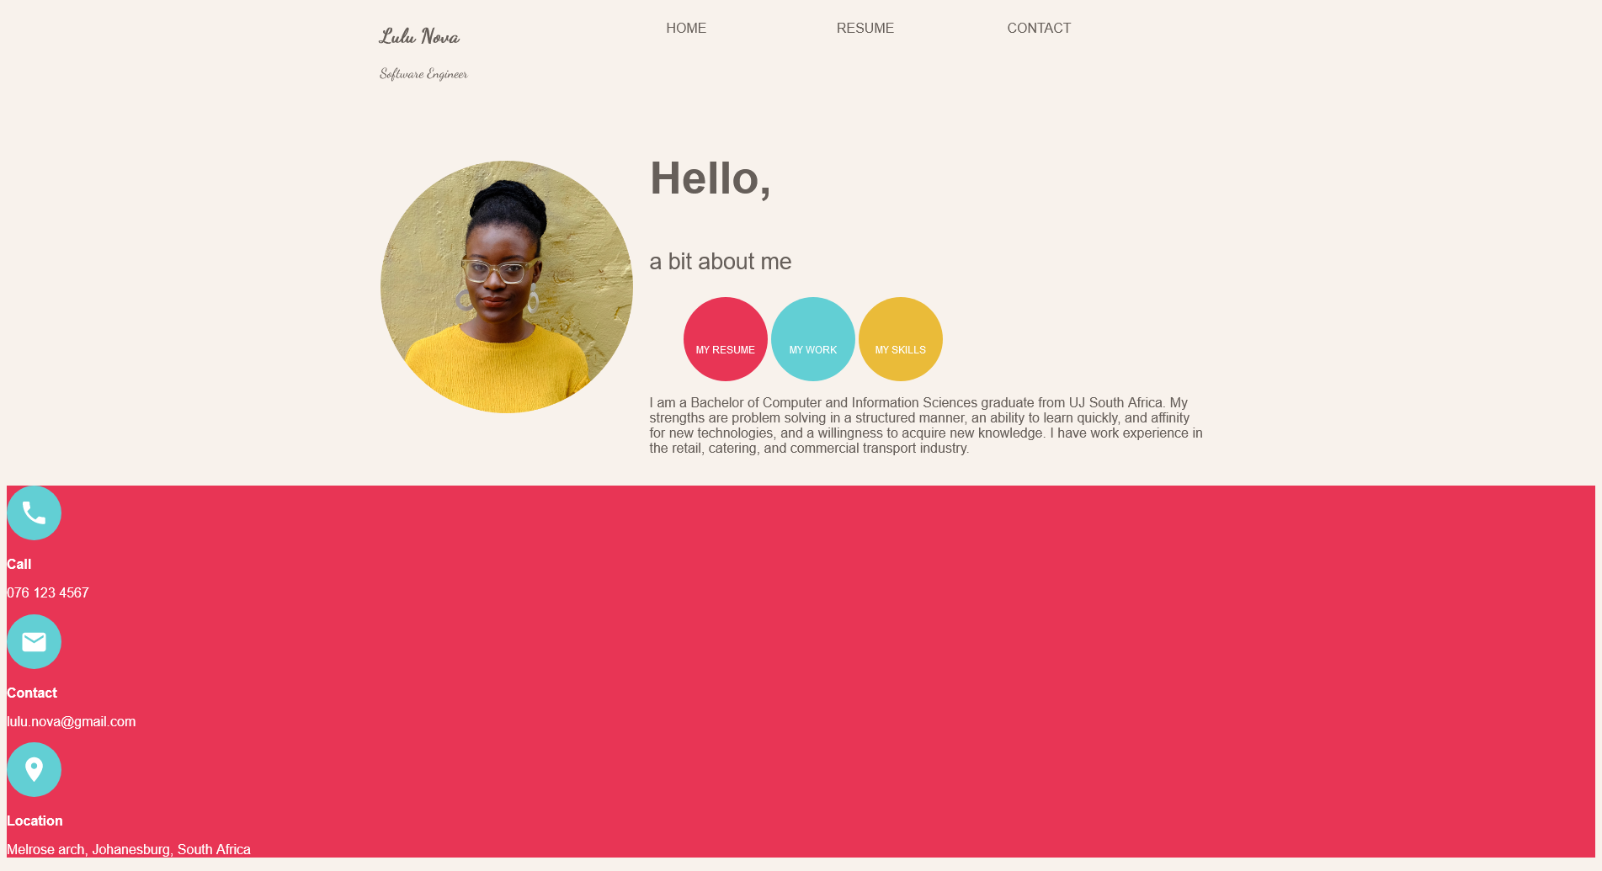
After today

Slide 8
1
Let’s get started
Open your CV or download the sample project

Slide 9

https://github.com/almarieSaayman/ladiesThatCode
Notes:
If you joined us last time you can just continue working with your existing CV template, Alternatively you can download it from github and we will share it in Microsoft teams.
Open it in a text editor and open the html file in your browser so you are ready for the activities in the upcoming sections
Note Go to website here and show how to download

Slide 10
2
External Stylesheets
Creating and linking stylesheets

Slide 11
Types of Style sheets
Inline – On every element
Internal – In a <style> tag
External – In an external CSS file
Notes:
Last time Patricia mentioned 3 locations.
The first one is inline styles where you apply styles to every element. That is the method we used last time.
The second one is internal styles. This is where you put a <style> tag inside your html <head> element. This method partially externalises style sheets: It is all in one place instead of on individual elements, but it is still inside the html file and can not be reused on other pages.
The third type is external style sheets. This is where all your CSS rules are in an external CSS file. This is the one we are going to be using today

Slide 12
Why external style sheets?
All in one place
Easier to maintain
Reuse styles for multiple elements
Reuse stylesheets across multiple pages

Slide 13
Activity 1 - Let’s make a style sheet!
Create a file called ‘cv.css’
Link it to your html file <link href="cv.css" rel="stylesheet" type="text/css">
Notes:
For the first activity we will be creating an external style sheet. Please wait for me to finish all 3 the steps, then you can go ahead and do it to your own CV.
First we will create the stylesheet file – let’s call it cv.css. Create it in the same folder as your html file
When you open your html file in the browser it will still look exactly the same. But if you open the developer tools and go to the sourtces tab it will show the css file

Slide 14
What goes in the stylesheet file?
The stylesheet file contains all your CSS rules
Every rule is built from a selector and style declarations
A style declaration contains a property and a value
Notes:
The stylesheet file contains all your CSS rules
Every rule is built from a selector and style declarations.
The selector determines which elements the styles should be applied to. The style declarations are the actual styles to apply.
Every style declaration contains a property and a value. The style declarations look exactly the same as the ones you used for inline styles in the previous session.

Slide 15
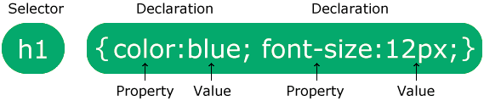
CSS Rule Syntax
selector {
property: value;
property: value;
}
Notes:
In the next section we will discuss exactly what selectors are and how we can use them. But for now, lets look at the syntax of a CSS Rule.
First we write the selector. After it we add a block with curly brackets around it.
Inside the curly brackets

Slide 16
3 Selectors
Selecting elements for your styles
Notes:
Next up we will be talking about selectors. Selectors tell the browser or css engine which elements to apply your styles too.

Slide 17
Selectors
Element
IDs
Classes
Combining Selectors
Notes:
We will be talking about 3 kinds of selectors:
Types – selecting by html element name
IDs
Classes
And then I will show you how to combine different selectors

Slide 18

Element Selectors
elementName { }
18
Notes:
Tag selectors are used to select all elements of a specific type

Slide 19
Element Selectors
Just use the tag name as the selector
h1 { } will select all h1 tags
body { } will select the body tag
div { } will select all div tags

Slide 20

ID Selectors
#name { }
20
Notes:
ID selectors are used to select a single element with a specific ID

Slide 21
ID Selectors
Use # with the ID
Example:
For Html <p id=“hello”>Hello</p>
Use Selector #hello { }
Notes:
If you give elements an ID you can use an id selector to apply styles to the element.
Remember, IDs must be unique.

Slide 22

Class Selectors
.name { }
22
Notes:
Class selectors are used to select all elements with a specific class. These elements do not all need the same class.

Slide 23
Class Selectors
Use . with the Class name
Example:
For Html <p class=“text”>Hello</p>
Use Selector .text { }

Slide 24
Summary
Element Selectors h1
ID Selectors #someId
Class Selectors .someClass

Slide 25
Activity 2
Move some of your styles to the external style sheet
Use an element selector for the body tag
Use id selectors to externalise the background colours of the three circles
Use a class selector for the rest of the styles on the circles
Remember to remove the inline styles!
Notes:
In this activity we will be moving some of our styles to the external style sheet. For each of the three items remove the inline styles and move them to the external css file.

Slide 26
Combining Selectors
element#id.class{ }
26
Notes:
Class selectors are used to select all elements with a specific class. These elements do not all need the same class.

Slide 27
Combining Selectors
Match all selectors (“And”)
Match any selectors (“Or”)
Match descendants of a selector
Notes:
We will look at 3 ways of combining selectors
Matching multiple selectors – for example, only select li tags with a specific class
Matching any selectors – selecting any ul or ol tags
Match descendants – Select any li element tags inside a tag with a specific id.

Slide 28
‘And’ selector - Match All
Chain selectors together
Example:
For Html <p class=“red”></p>
Use Selector p.red { }
Notes:
Note – Add picture examples!!!!!

Slide 29
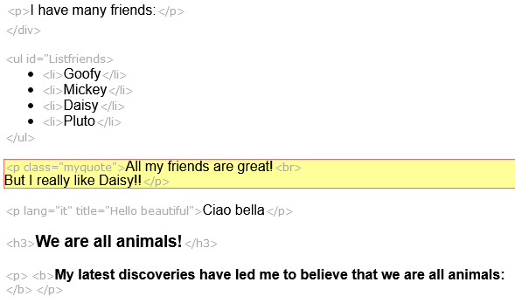
Match All - Example
Selector: p.myqyote
Notes:
Select all paragraph elements that have the class myquote

Slide 30
‘Or’ Selector - Match Any
Separate selectors with commas
Example:
For Html <p>Something</p> <a>More</a>
Use Selector p, a { }
Notes:
This selector is also sometimes called the “grouping” selector

Slide 31
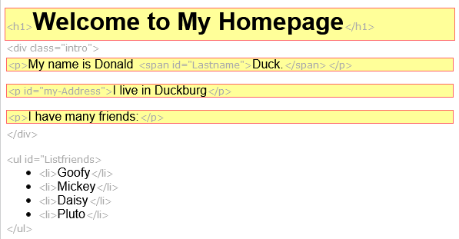
Match Any - Example
Selector: h1, p
Notes:
Select all h1 elements and all p elements

Slide 32
Match Descendants
Separate selectors with spaces
Example:
nav .nav-item {}
#footer .label {}
ul li
Notes:
Note – Add picture examples!!!!!
The last combinator I will be talking about is to match descendants. Remember that your html is like a tree: So when I say descendants I talk about any tag that is nested inside another one
The first example selects the nav element and then select any classes .nav-item inside it.
The second example selects the element with the footer id and then selects any tags inside it that have the label class
The third example selects any list item tags that are in an unordered list, but not those in an ordered list.

Slide 33
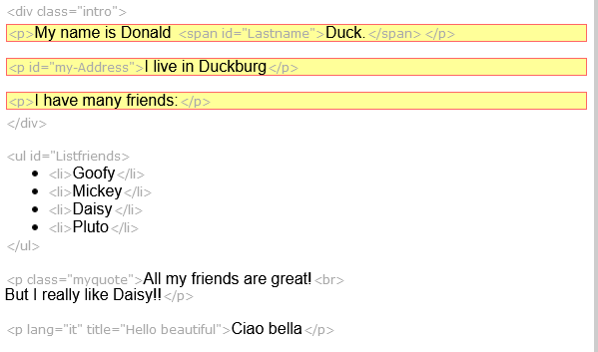
Match Descendants - Example
Selector: .intro p
Notes:
Select all p elements that are inside the element with class intro

Slide 34
Summary
‘And’ selector p.myqyote
‘Or’ selector h1, p
Descendant combinator .intro p
Play with selectors https://www.w3schools.com/cssref/trysel.asp
Notes:
https://www.w3schools.com/cssref/trysel.asp

Slide 35
Helpful Links
Selectors Reference
https://developer.mozilla.org/en-US/docs/Web/CSS/CSS_Selectors
https://www.w3schools.com/cssref/css_selectors.asp
Notes:
https://www.w3schools.com/cssref/trysel.asp
https://developer.mozilla.org/en-US/docs/Web/CSS/CSS_Selectors
https://www.w3schools.com/cssref/css_selectors.asp

Slide 36
Activity 3
Use descendant combinators to move more styles to the external style sheet
Use a descendant combinator to style the li elements that are inside the header element
Use a descendant combinator to style the p tags “My Resume”, “My Work” and “My Skills”
Remember to remove your inline styles!
Notes:
In this activity we will be moving some of our styles to the external style sheet. For each of the three items remove the inline styles and move them to the external css file.

Slide 37
4
Layout and positioning
Properties used for layout and positioning

Slide 38
CSS Properties for Layout
Display
Width
Height
Margin
Notes:
In this activity we will be moving some of our styles to the external style sheet. For each of the three items remove the inline styles and move them to the external css file.

Slide 39

Width and Height
Use the width and height properties to set the size of the elements
Use the units discussed in CSS Part 1: px, %, cm
39
Notes:
Class selectors are used to select all elements with a specific class. These elements do not all need the same class.

Slide 40
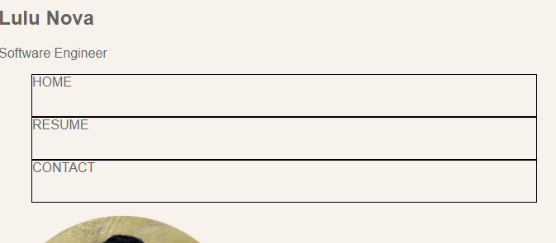
Width and Height Example
nav li {
width: 33%;
height: 50px;
}
40
Notes:
Class selectors are used to select all elements with a specific class. These elements do not all need the same class.
Note Add picture examples - Before and After

Slide 41
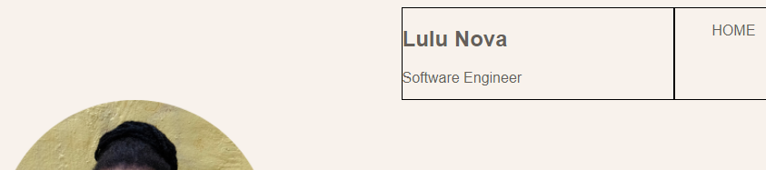
Alignment - Center
Use margins to align elements
To center an element horizontally use margin: auto;
Notes:
Note – Add picture examples!!!!!
Before and After

Slide 42
Activity 4 – Sizing and Centering
Set the width of the header and article elements
Align the header and article elements in the center of the page (hint: Use margin)
Set the width of the three li elements in the header to 30% each.
Set the width and height of the section and nav elements in the header
Notes:
In this activity we will be moving some of our styles to the external style sheet. For each of the three items remove the inline styles and move them to the external css file.

Slide 43
Display
Changes layout of a single element
43
Notes:
Class selectors are used to select all elements with a specific class. These elements do not all need the same class.

Slide 44
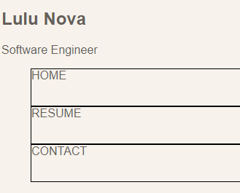
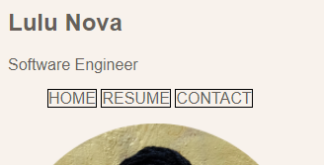
Display – Possible Values
block Starts on a new line and takes up the whole width
inline Like text. Height and width has no effect

Slide 45

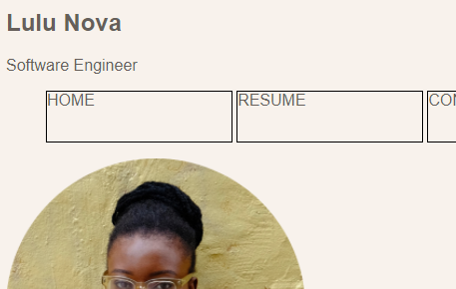
Display – Possible Values
inline-block Block elements next to each other.
None Element is hidden

Slide 46
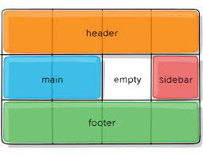
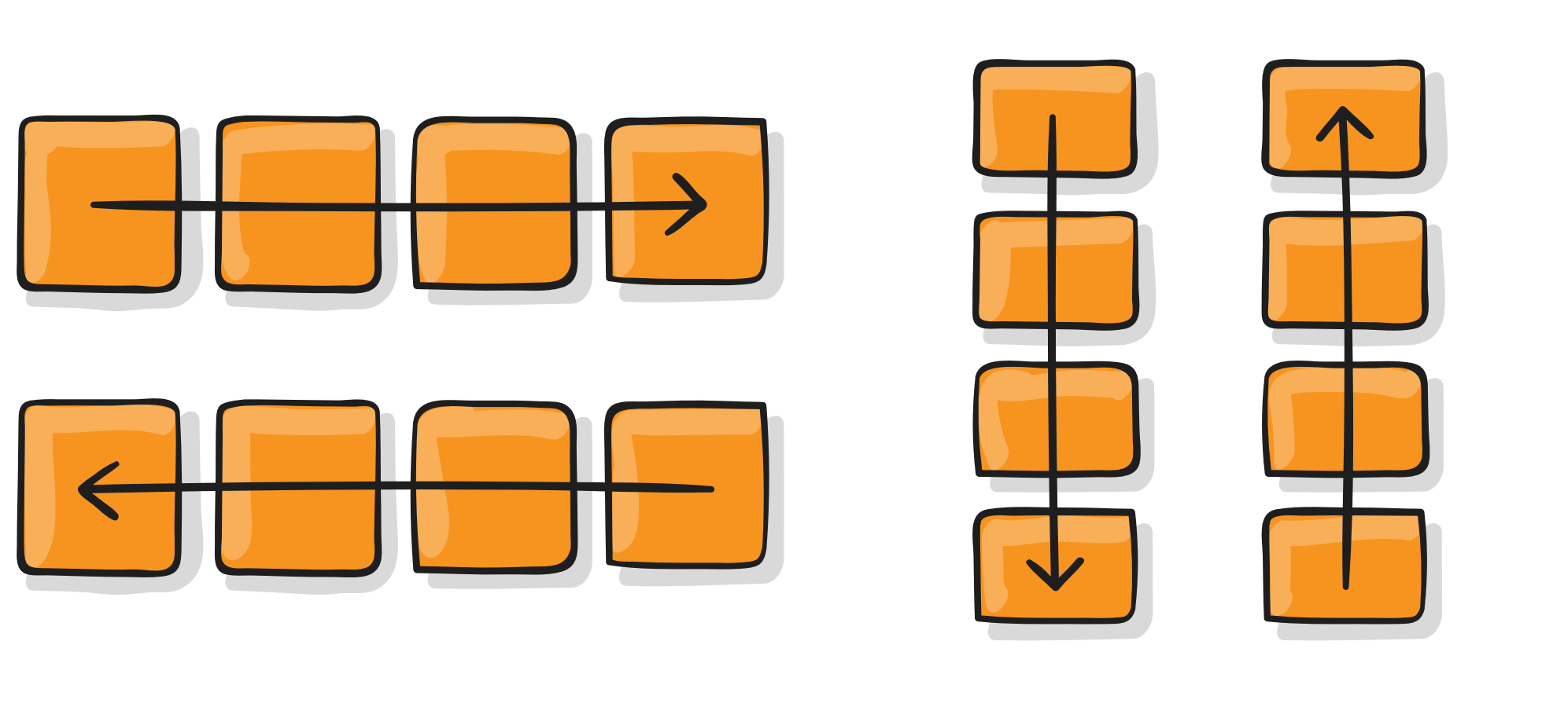
Advanced Display Modes
flex – aligns items in a row or column
grid – aligns items in two dimensions
Notes:
There are some advanced display options that I’m not going to discuss in depth today. These display types are very powerful and allow you create complex responsive layouts but are also harder to use than the basics covered today.
The first one is display flex (also sometimes called flex boxes). It lays elements out in one dimension (row or column)
The main idea behind the layout is to give the container the ability to alter its items’ width/height to best fill the available space (mostly to accommodate to all kind of display devices and screen sizes).
The second item is the grid layout. Grid layout is a new, modern way of laying out grids in CSS. It is more complex than flex and works in two dimensions instead of one. You can even use flex and grid together in more complex layouts.
And inline- variants for these…

Slide 47
Activity 5 – Set display modes
Align all the li elements horizontally using one of the basic display types (hint: use block, inline, or inline-block)
Apply one of the advanced display types on the header and article elements to align their children next to each other (hint: use flex or grid)
Set the width of the section elements in the article (hint: make sure you select the right sections)
Notes:
In this activity we will be moving some of our styles to the external style sheet. For each of the three items remove the inline styles and move them to the external css file.

Slide 48

Activity – On your own time
Align the items in the footer to match the picture.
(Hint: You can add additional html in the footer)

Slide 49
Helpful Links
Flexbox Layouts
https://css-tricks.com/snippets/css/a-guide-to-flexbox/
Grid Layout
https://css-tricks.com/snippets/css/complete-guide-grid/

Slide 50
4
Fun Extra: Google Fonts
Custom fonts for the web

Slide 51
Activity 6
Go to https://fonts.google.com
Choose a font
Select a style
Copy the HTML & CSS into your website
Use the font-family property to apply the font!
Notes:
Remember – do not use too many different fonts and make sure your website is still easy to read!

Slide 52
Thanks!
ANY QUESTIONS?

Slide 53
SlidesCarnival icons are editable shapes.
This means that you can:
Resize them without losing quality.
Change fill color and opacity.
Isn’t that nice? :)
Examples:

Slide 54
Now you can use any emoji as an icon!
And of course it resizes without losing quality and you can change the color.
How? Follow Google instructions https://twitter.com/googledocs/status/730087240156643328
😉
✋👆👉👍👤👦👧👨👩👪💃🏃💑❤😂😉😋😒😭👶😸🐟🍒🍔💣📌📖🔨🎃🎈🎨🏈🏰🌏🔌🔑

